Slide 1
The Battle of Hastings
The Invasion of England

Slide 2
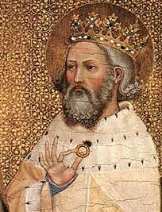
King Edward of England (called "The Confessor" because of his construction of Westminster Abbey) died on January 5, 1066, after a reign of 23 years. Leaving no heirs, Edward's passing ignited a three-way rivalry for the crown that culminated in the Battle of Hastings and the destruction of the Anglo-Saxon rule of England.

Slide 3
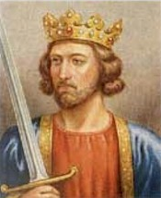
The leading predecessor was Harold Godwinson, the second most powerful man in England and an advisor to Edward. Harold and Edward became brothers-in-law when the king married Harold's sister. Harold's powerful position, his relationship to Edward and his esteem among his peers made him a logical successor to the throne. His claim was strengthened when the dying Edward supposedly uttered "Into Harold's hands I commit my Kingdom." With this kingly endorsement, the Witan (the council of royal advisors) unanimously selected Harold as King. His coronation took place the same day as Edward's burial. With the placing of the crown on his head, Harold's troubles began.

Slide 4
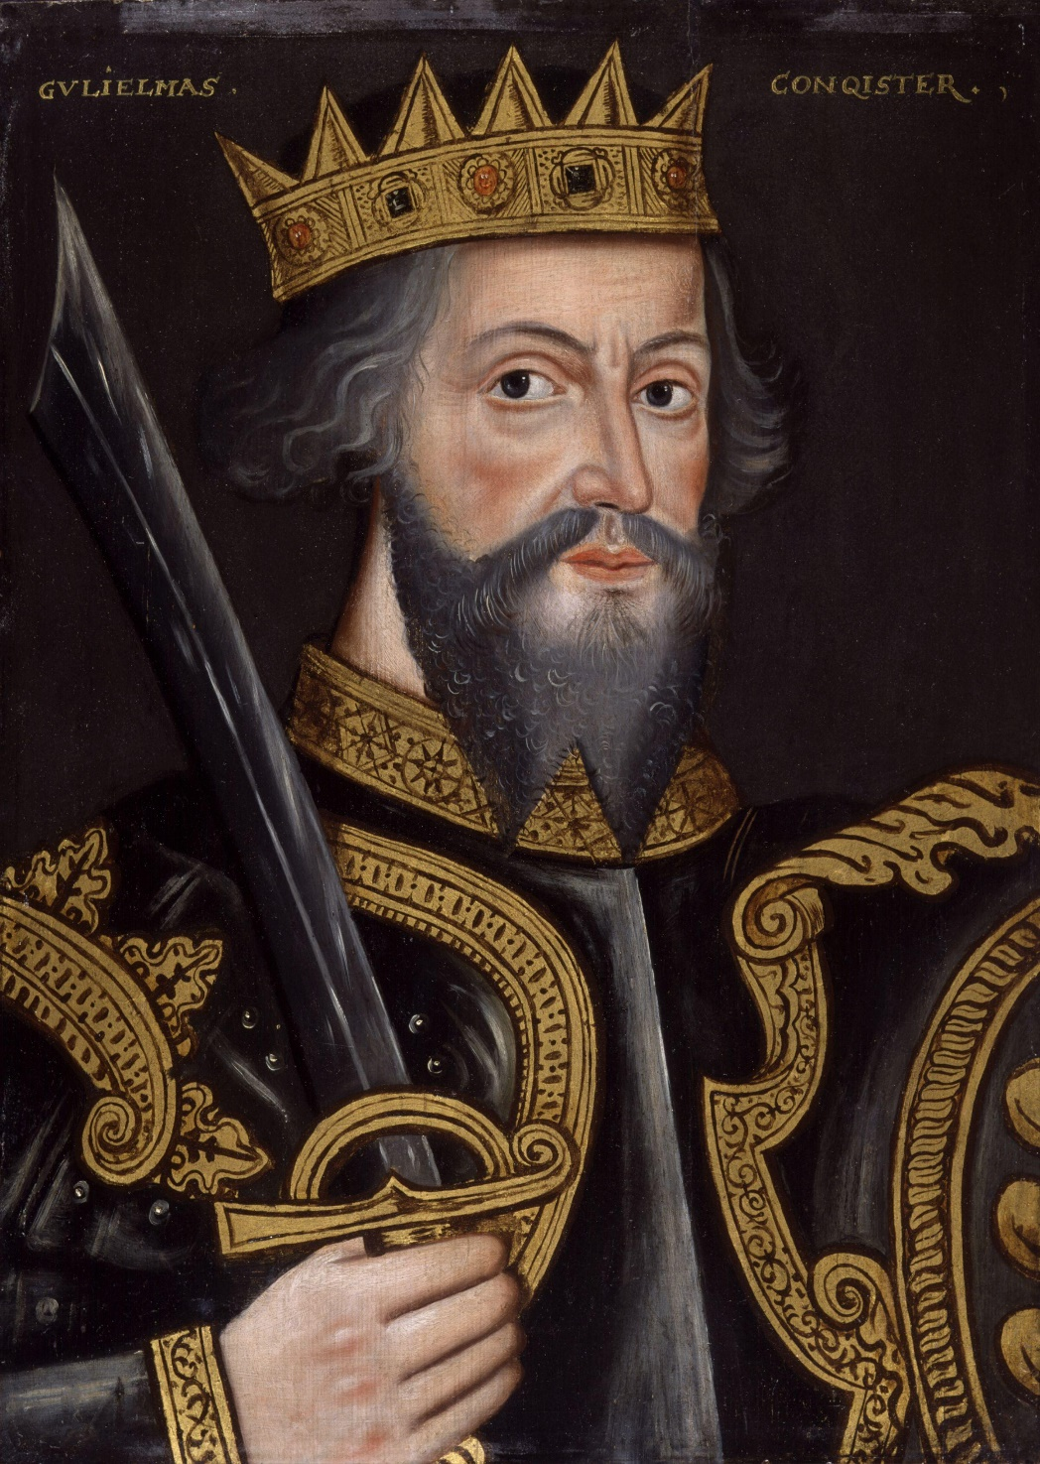
Across the English Channel, William, Duke of Normandy, also laid claim to the English throne. William justified his claim through his blood relationship with Edward (they were distant cousins) and by stating that some years earlier, Edward had designated him as his successor. To compound the issue, William asserted that the message in which Edward anointed him as the next King of England had been carried to him in 1064 by none other than Harold himself.

Slide 5
From William's perspective, when Harold donned the Crown he not only defied the wishes of Edward but had violated a sacred oath. He immediately prepared to invade England and destroy the upstart Harold. Harold's violation of his sacred oath enabled William to secure the support of the Pope who promptly excommunicated Harold, consigning him and his supporters to an eternity in Hell.

Slide 6
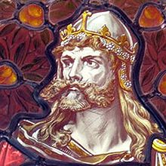
The third rival for the throne was Harald Hardrada, King of Norway. His justification was even more tenuous than William's. Hardrada ruled Norway jointly with his nephew Mangus until 1047 when Mangus conveniently died. Earlier (1042), Mangus had cut a deal with Harthacut the Danish ruler of England. Since neither ruler had a male heir, both promised their kingdom to the other in the event of his death. Harthacut died but Mangus was unable to follow up on his claim to the English throne because he was too busy battling for the rule of Denmark. Edward became the Anglo-Saxon ruler of England. Now with Mangus and Edward dead, Hardrada asserted that he, as Mangus's heir, was the rightful ruler of England. When he heard of Harold's coronation, Hardrada immediately prepared to invade England and crush the upstart.

Slide 7

Who will succeed and win the crown?
William, Duke of Normandy?
Harold Godwinson?
Harald Harada?

Slide 8
Hardrada of Norway struck first. In mid September, Hardrada's invasion force landed on the Northern English coast, sacked a few coastal villages and headed towards the city of York. Hardrada was joined in his effort by Tostig, King Harold's nere-do-well brother. The Viking army overwhelmed an English force blocking the York road and captured the city. In London, news of the invasion sent King Harold hurriedly north at the head of his army picking up reinforcements along the way. The speed of Harold's forced march allowed him to surprise Hardrada's army on September 25, as it camped at Stamford Bridge outside York.

Slide 9
A fierce battle followed. Hand to hand combat ebbed and flowed across the bridge. Finally the Norsemen's line broke and the real slaughter began. Hardrada fell and then the King's brother, Tostig. What remained of the Viking army fled to their ships. So devastating was the Viking defeat that only 24 of the invasion force's original 240 ships made the trip back home. Resting after his victory, Harold received word of William's landing near Hastings.

Slide 10
Harold rushed his army south and planted his battle standards atop a knoll some five miles from Hastings. During the early morning of the next day, October 14, Harold's army watched as a long column of Norman warriors marched to the base of the hill and formed a battle line. Separated by a few hundred yards, the lines of the two armies traded taunts and insults. At a signal, the Norman archers took their position at the front of the line. The English at the top of the hill responded by raising their shields above their heads forming a shield-wall to protect them from the rain of arrows. The battle was joined.

Slide 11

The English fought defensively while the Normans infantry and cavalry repeatedly charged their shield-wall. As the combat slogged on for the better part of the day, the battle's outcome was in question. Finally, as evening approached, the English line gave way and the Normans rushed their enemy with a vengeance.

Slide 12
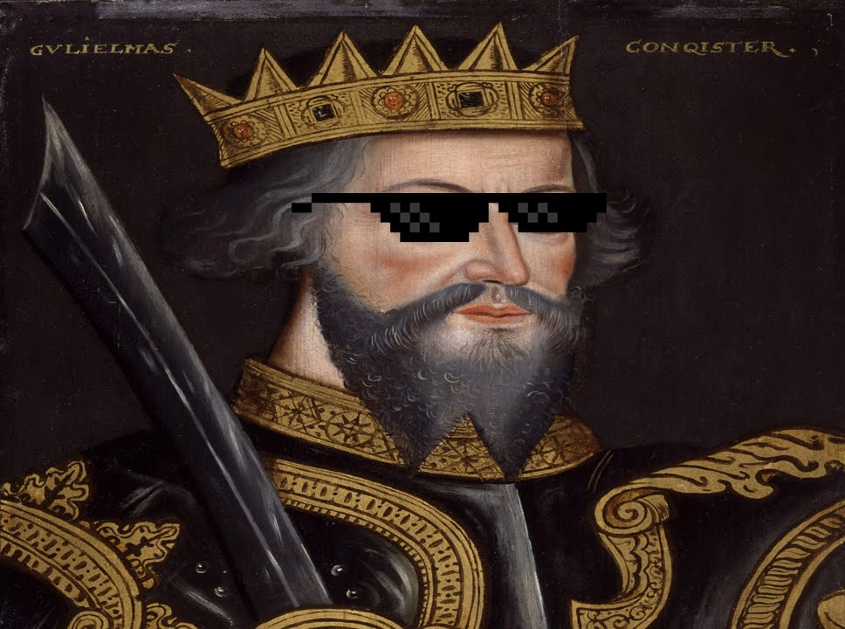
King Harold fell as did the majority of the Saxon aristocracy. William's victory was complete. On Christmas day 1066, William was crowned King of England in Westminster Abbey.

Slide 13
The Bayeux Tapestry (actually an embroidery measuring over 230 (70m) feet long and 20 inches (m) wide) describes the Norman invasion of England and the events that led up to it. It is believed that the Tapestry was commissioned by Bishop Odo, bishop of Bayeux and the half-brother of William the Conqueror. The Tapestry contains hundreds of images divided into scenes each describing a particular event. The scenes are joined into a linear sequence allowing the viewer to "read" the entire story starting with the first scene and progressing to the last. The Tapestry would probably have been displayed in a church for public view.

Slide 14
History is written by the victors and the Tapestry is above all a Norman document. In a time when the vast majority of the population was illiterate, the Tapestry's images were designed to tell the story of the conquest of England from the Norman perspective. It focuses on the story of William, making no mention of Hardrada of Norway nor of Harold's victory at Stamford Bridge.

